Slide 1





CSYE 7280 User Experience Design/Testing Professor Vishal Chawla
Group 17
Vaishnavi Khismatrao (001523415 )
Abhinav Choudhary (002780326)
Riya Rajesh Patil (002791006)
Ritvik Saxena (002747239)
Rucha Sachin Chauthai (002100149 )
Viral Jangale (002654463 )

Slide 2

About the project
The HomeBro is one online destination for users to buy home décor things and fulfill all their home decoration needs.
The app makes it convenient for users to get the products that are high on design & unique.
The app has special features to facilitate user’s work.

Slide 3



Product Objectives

Slide 4
Wide range of fashionable and high-quality home décor items
Streamline the process of locating and buying items, with online or in-store options
Provide design advice and suggestions
Offer cutting-edge technology, such as augmented reality and voice accessibility
Enable communication with chatbot
Provide quick and effective customer service
Foster a sense of community with their social network
Establish a strong brand identity
Exceptional support from trained interior design professionals.
Provide guides and videos to demonstrate how to use various tools on the application.

Slide 5
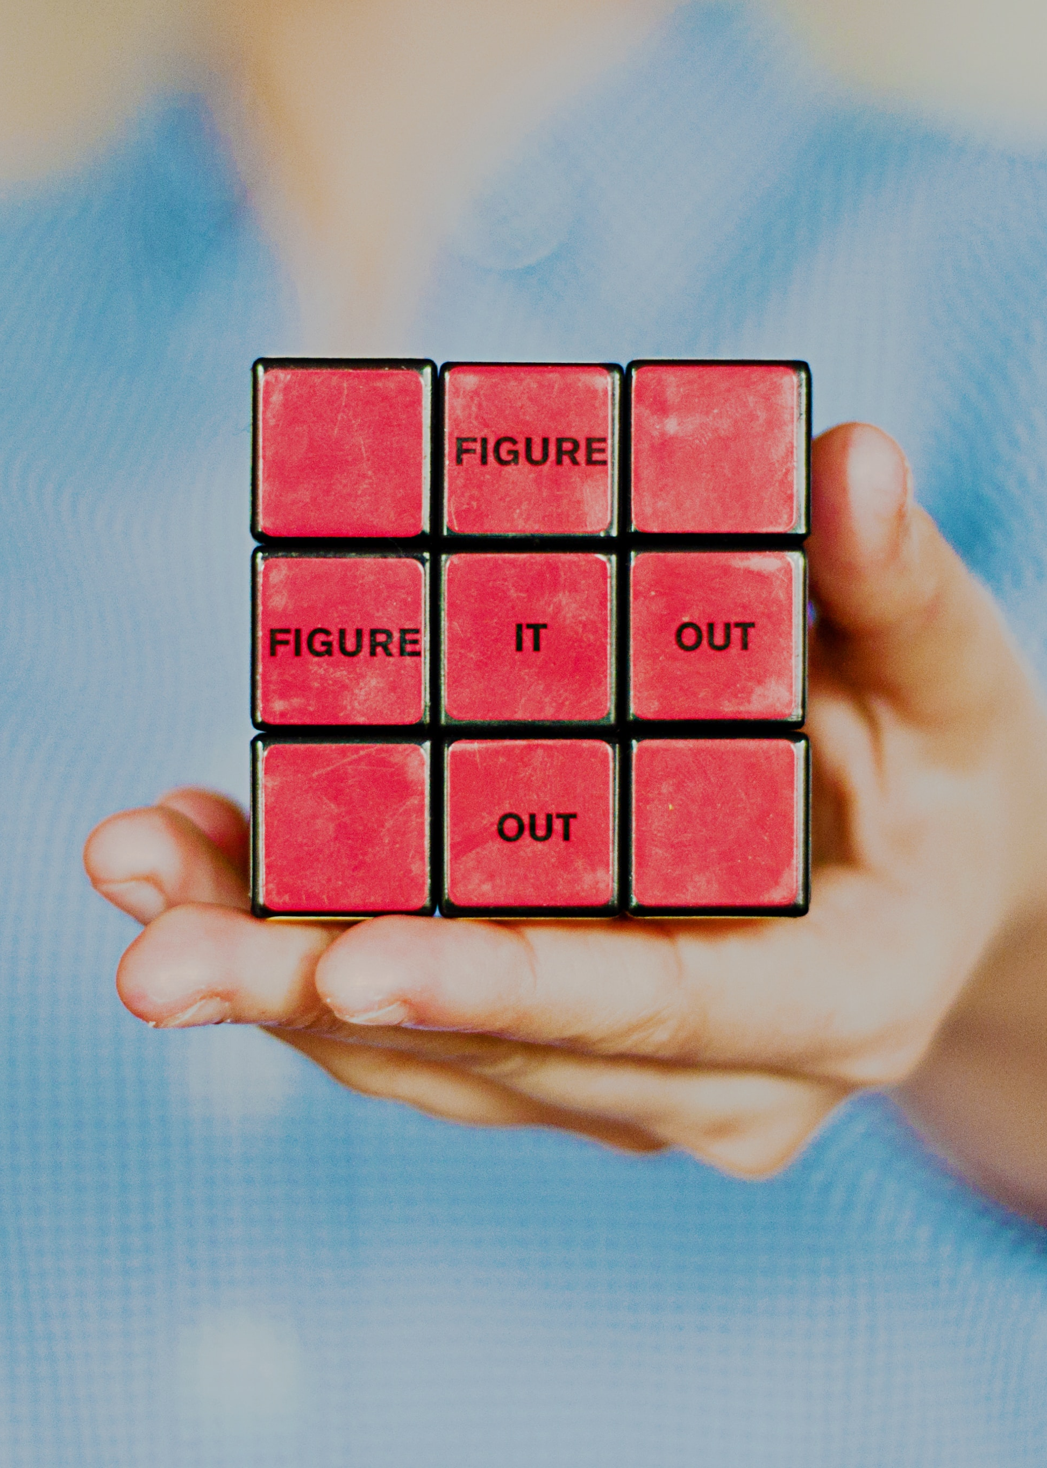




Problem Statement and Solution

Slide 6

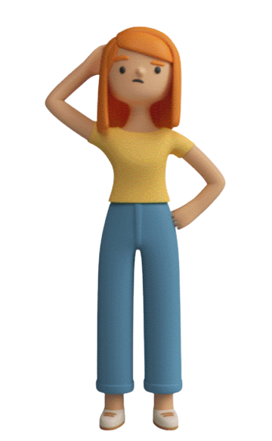




People struggle to collect all the decoration items in one location.
Uncertainty regarding the size and quality of decorative items as well as fit of the product in the customer’s space.
It’s difficult to visit a physical store and compare different home decoration products.
They sometimes don’t know the product name.
People sometimes do not know how to decorate a space and want inspiration

Slide 7
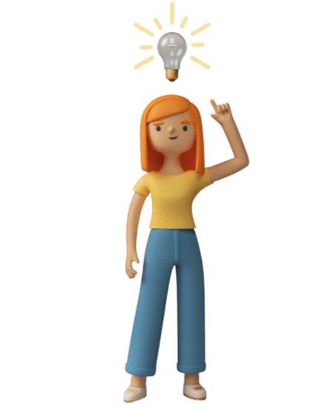
For customers to assess the compatibility of items, HomeBro offers an augmented reality option.
Great deals on high quality interior items that are delivered at your doorstep in your timeframe.
Connect our users with a team of design experts to alleviate design challenges and get expert opinion.
Provide AI Chatbot functionality to solve basic queries like product type, name, etc.

Slide 8

Personas

Slide 9
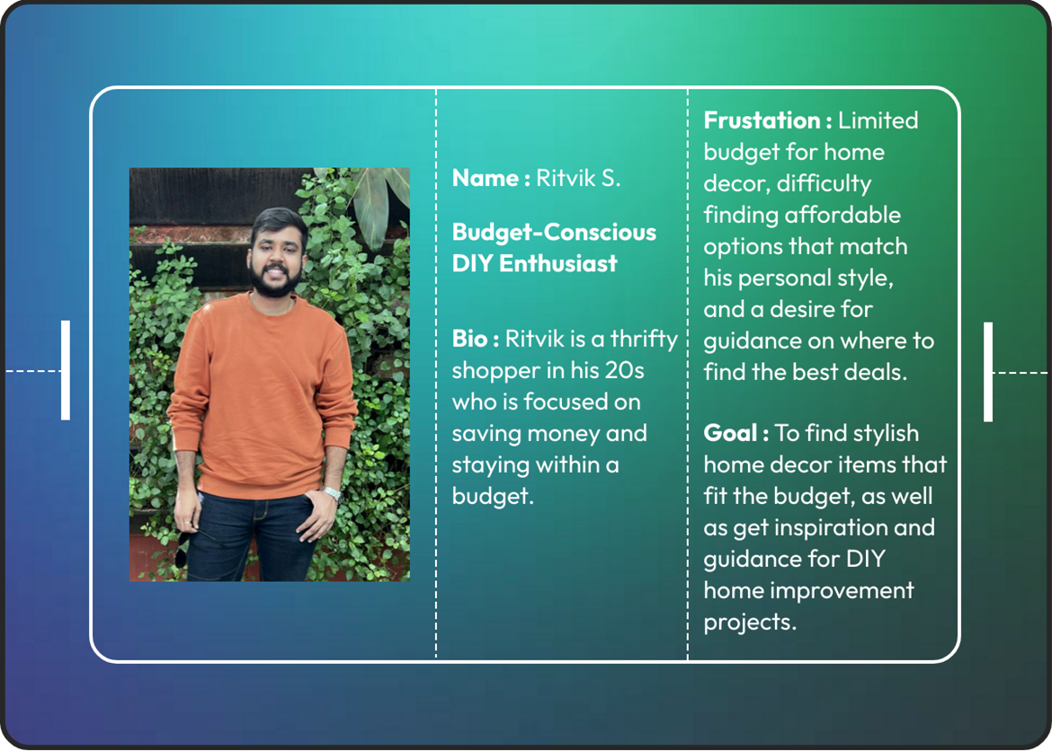

Slide 10
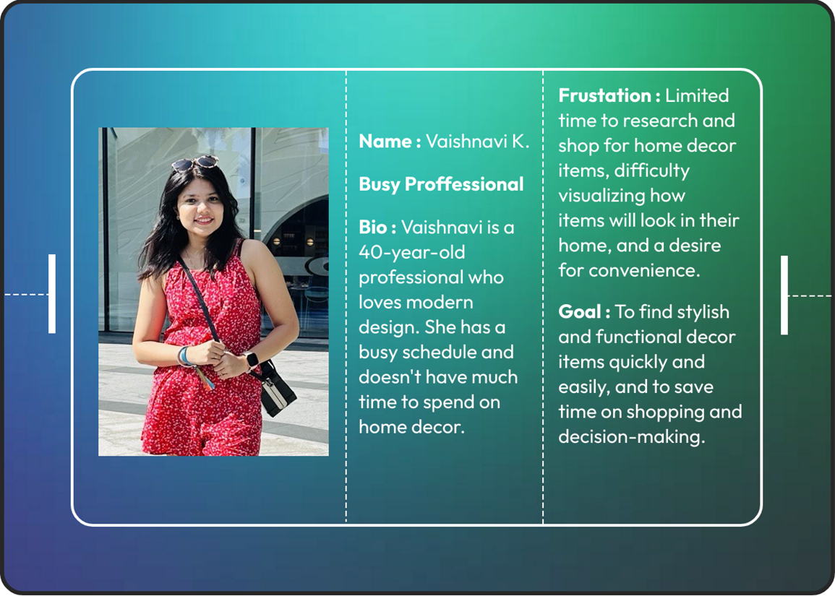

Slide 11
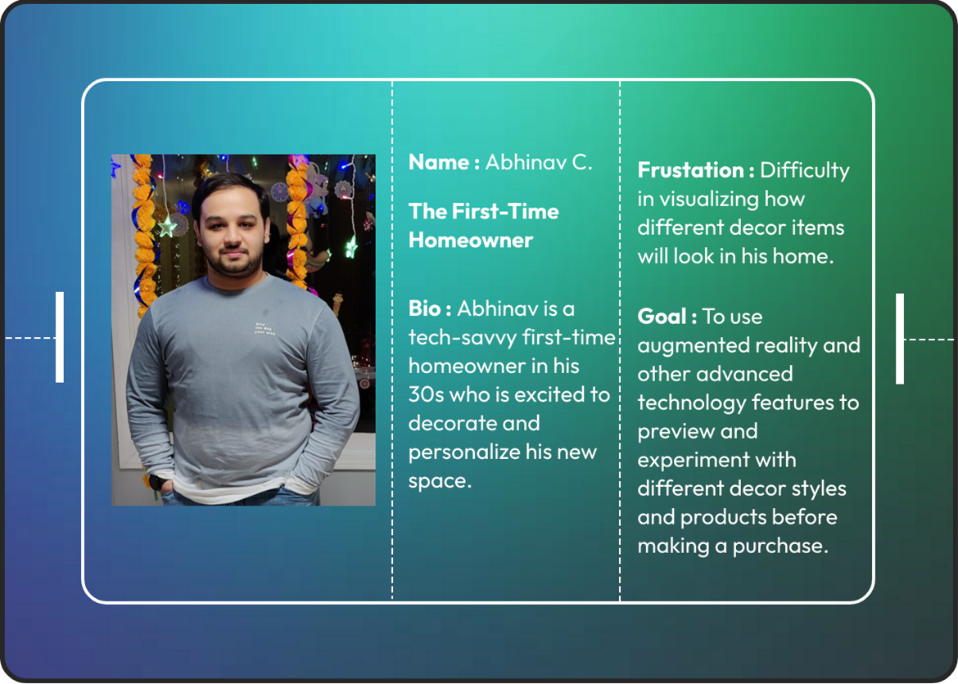

Slide 12
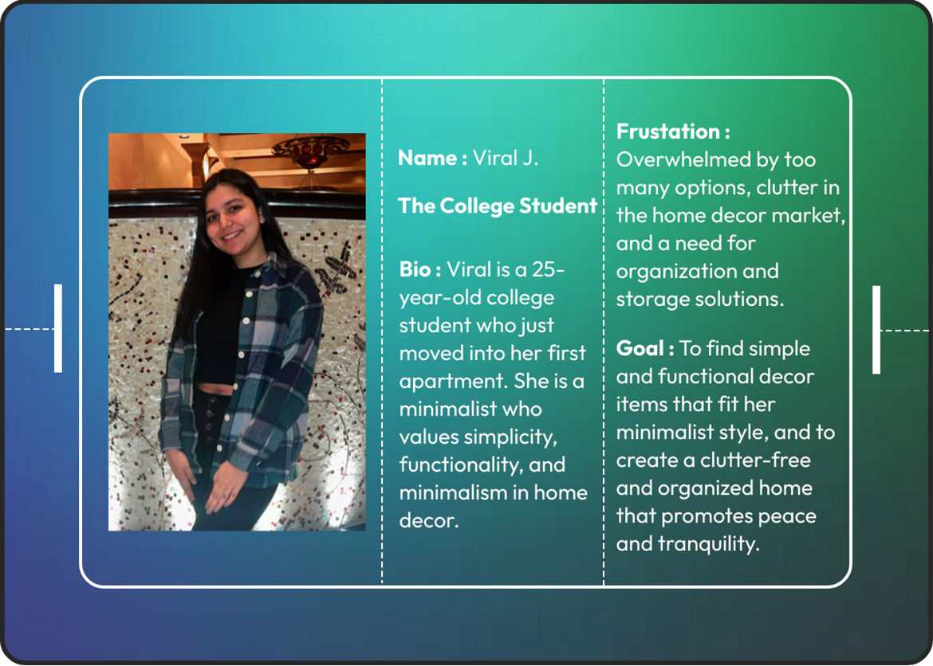

Slide 13


Design System

Slide 14




Typography: We have used legible typography as per Google material guidelines – font family: Montserrat.
Consistency: We have designed the elements to look & behave consistently across the entire application
Interaction Design: We have included advanced features like voice accessibility and feedback, to create an intuitive user experience
Plugins: Material Design Icons | Transitions: Loading screen on launch, Onboarding screen, vertical scroll, horizontal scroll | Animations: Slide In, Move in(On Drag and On Tap), After Delay
Logo Design & Color: We used background colors DAD3C8 & 9C9790 to ensure accessibility. The HomeBro Logo is designed in Canva to make it memorable & build the personality of our brand

Slide 15
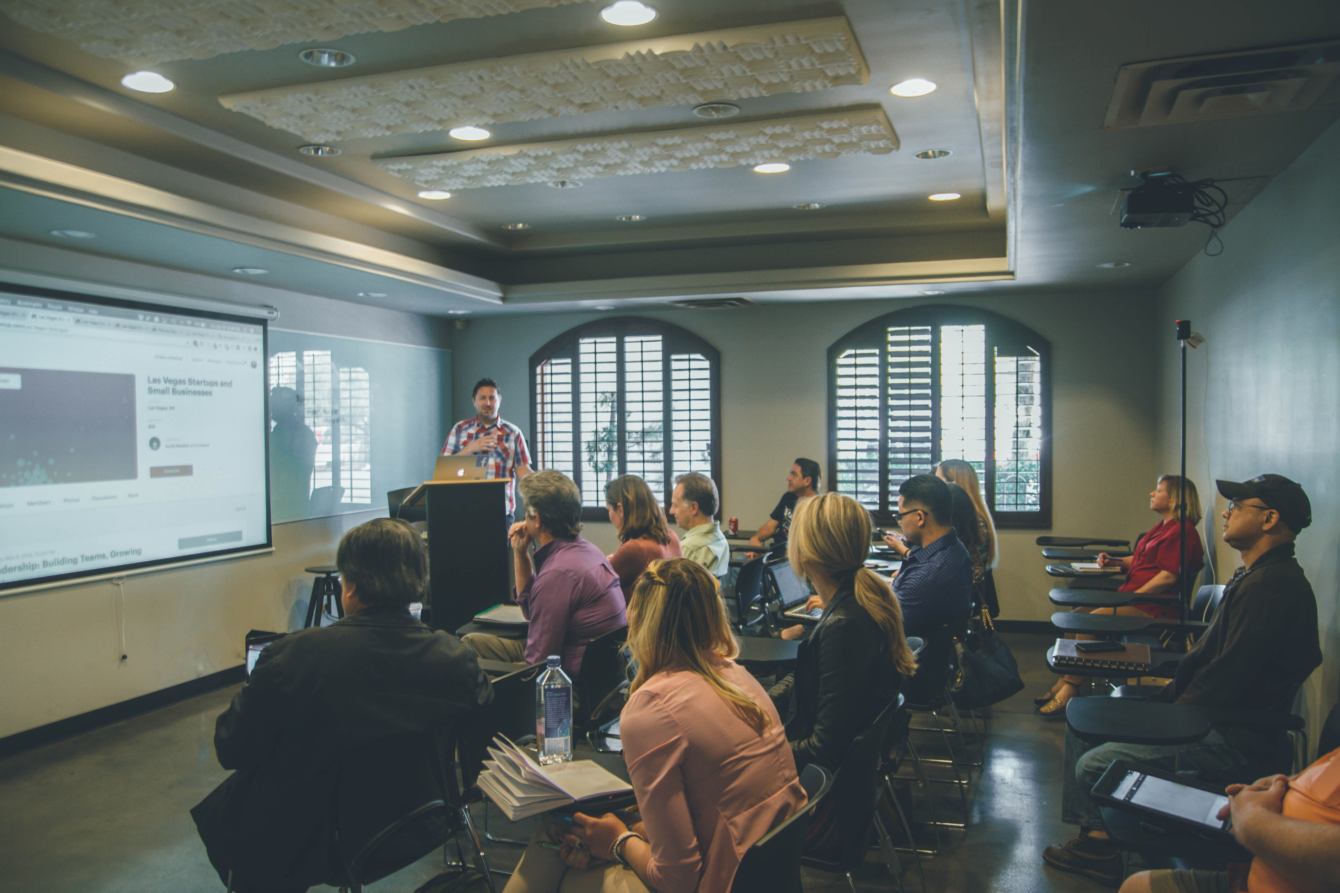
Target Audience

Slide 16

Homeowners
Renters
Home buyers
DIY enthusiasts
Design-conscious consumers
Busy professionals
Interior Designers
First-time buyers

Slide 17
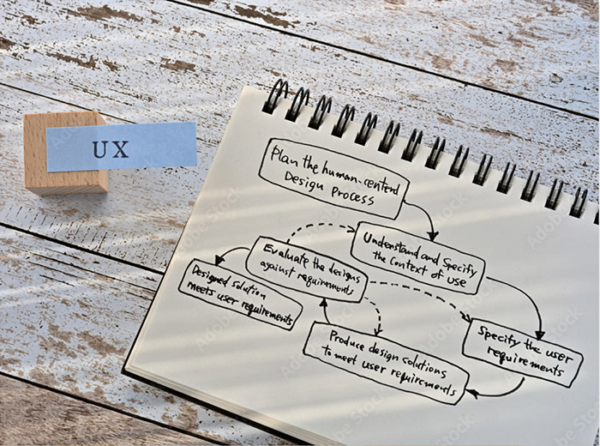
Design Process

Slide 18

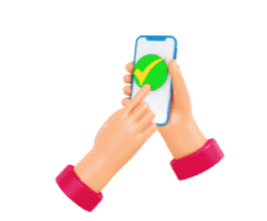

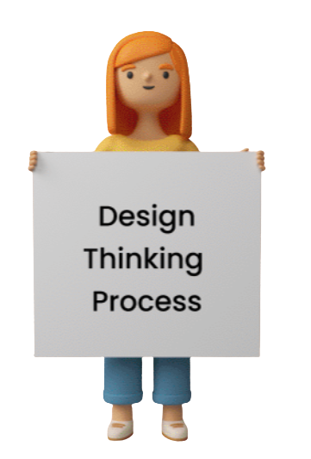
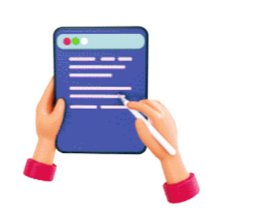

User Research
User Interviews
Empathize
Usability Testing
Problem Statement
Persona
Test
Define
Wireframes
Visual Design
Prototypes
User Flow
Information Architecture
Prototype
Ideate

Slide 19
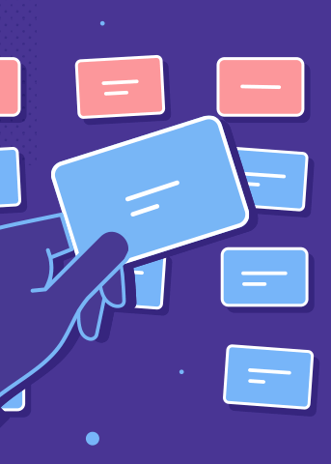
Card Sorting

Slide 20
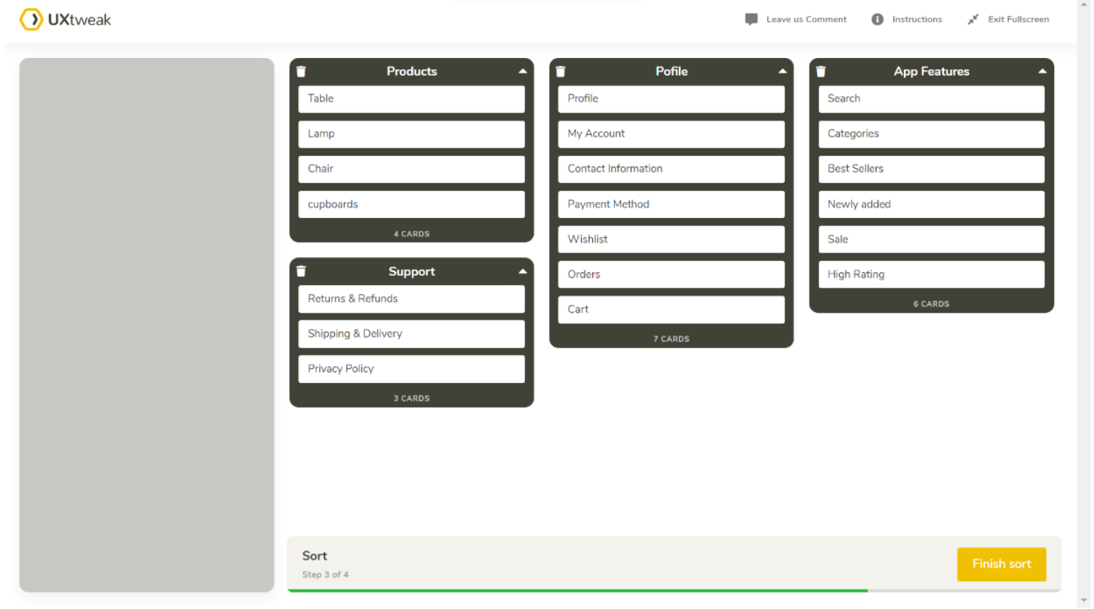
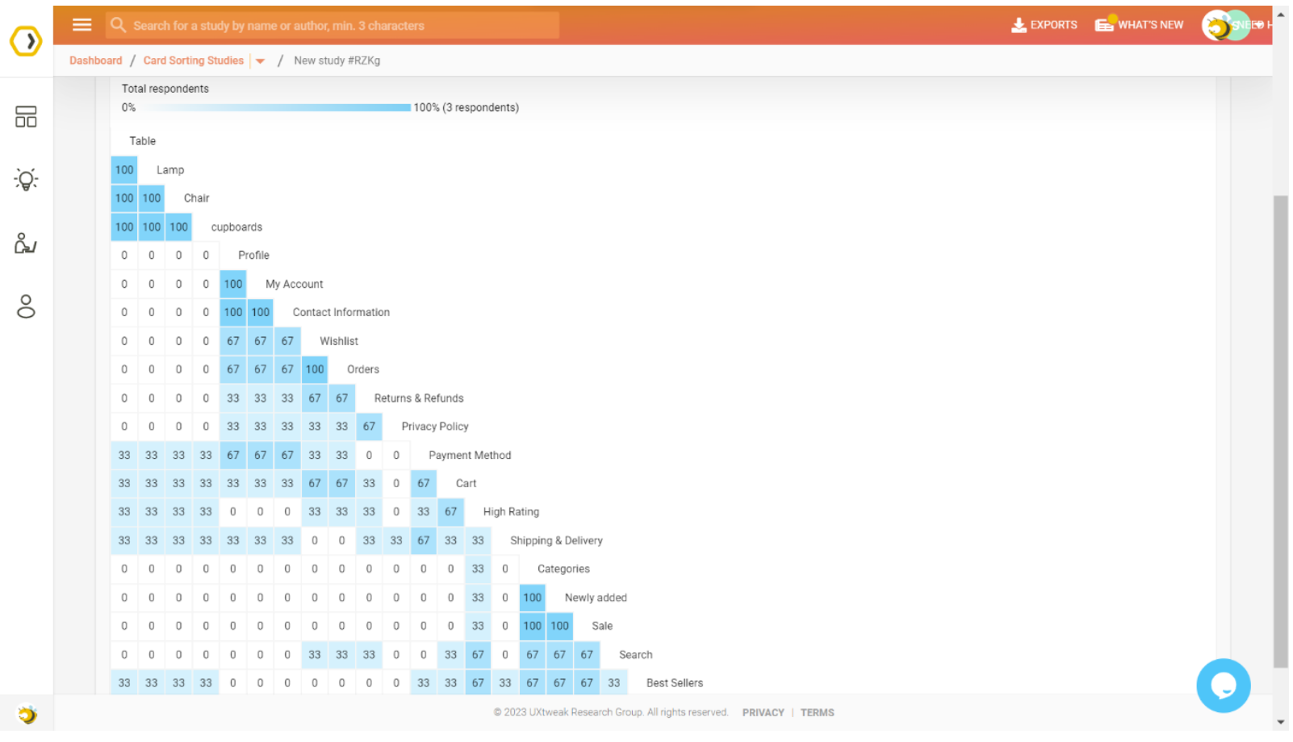
Open Card Sorting
We instructed the users to sort the items into categories they deemed appropriate and to name the categories.
Analysis of the Similarity Matrix of the Respondents, helped us understand how users mentally categorize different types of products while looking to enhance their home décor.

Slide 21
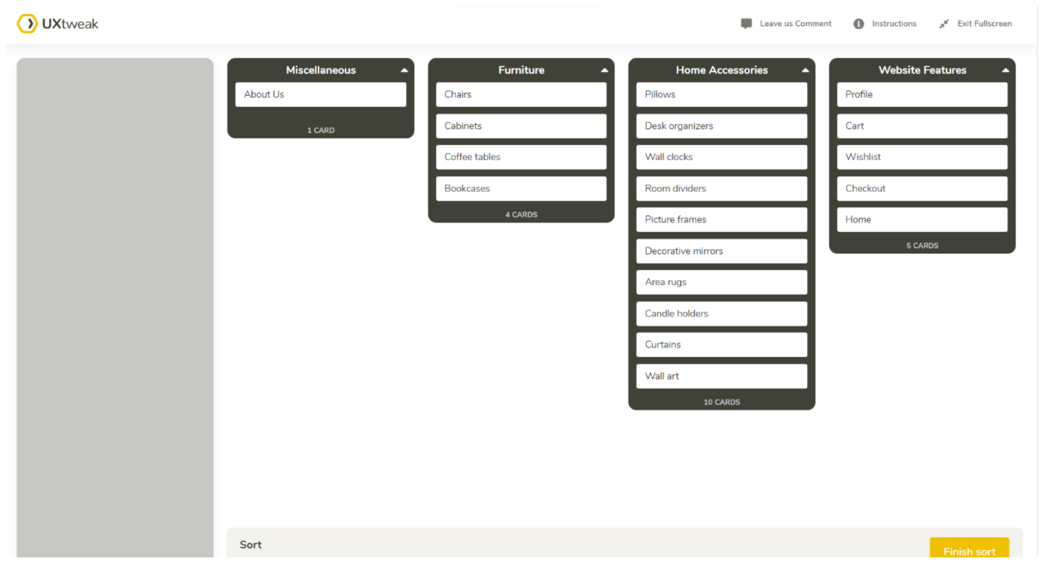
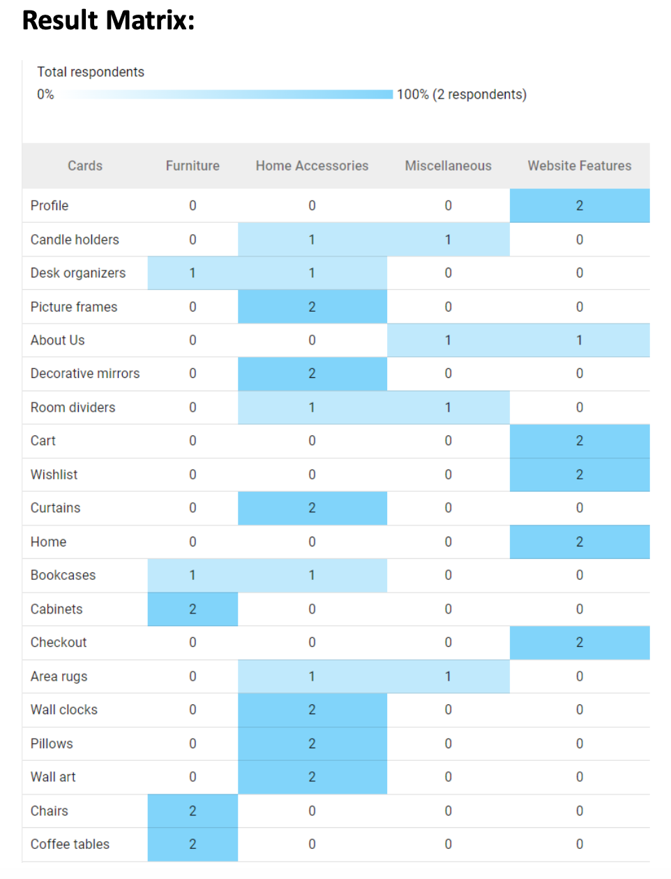
Closed Card Sorting
We instructed the users to sort the items into categories they deemed appropriate and to name the categories.
Analysis of the result matrix, helped us understand the best way a user can get access to the submenu options from the main header.

Slide 22
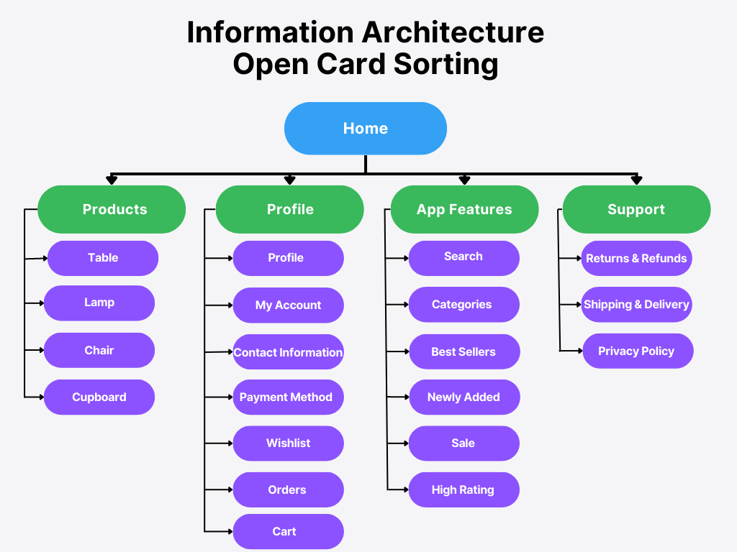
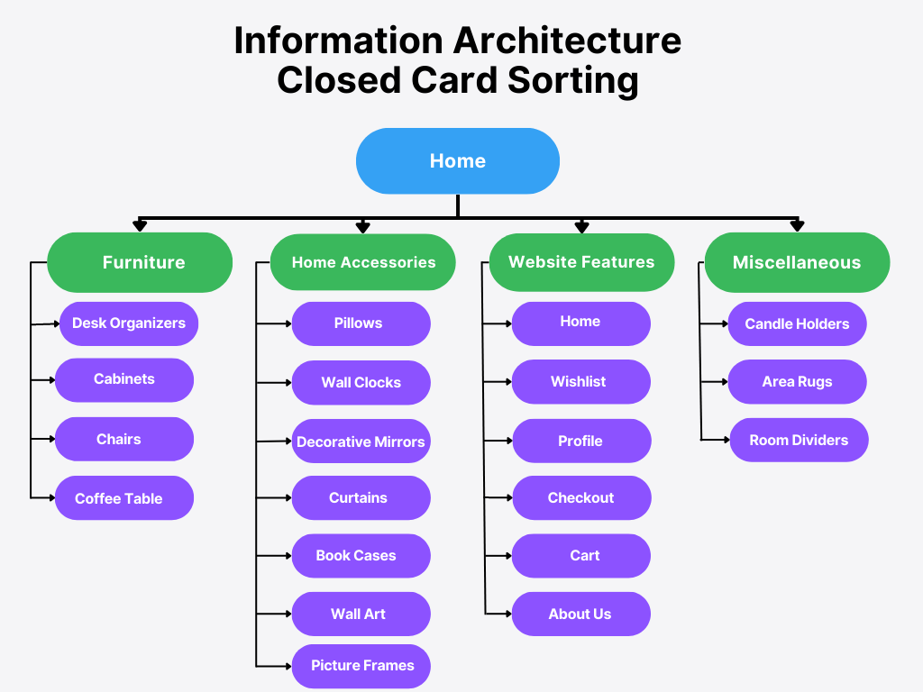
Information Architecture / User Workflow

Slide 23

User Needs

Slide 24
Creative Inspiration: Wide range of home décor styles, themes, ideas to inspire customers.
Product Information in detail: Access to information such as dimensions, specifications, colors, reviews, etc.
Product Availability: Clear information about stock levels, delivery times, etc.
Integration with popular social media platforms: Integration with platforms like Facebook, Instagram, interest, etc.
User-Friendly Navigation: Easy to navigate and search for seamless shopping experience.
High-Quality Images: Detailed, accurate, eye-pleasing representation of products.
Secure Checkout Process: Safeguarding of customer’s information and payment details.
Customer Service: Reliable customer service like live chat, customer support helpline.
Delivery Options: Variety of delivery options like standard, express, one-day delivery.
Returns and Refund Policy: Detailed information about returns and refund procedure with a proper timeline.

Slide 25
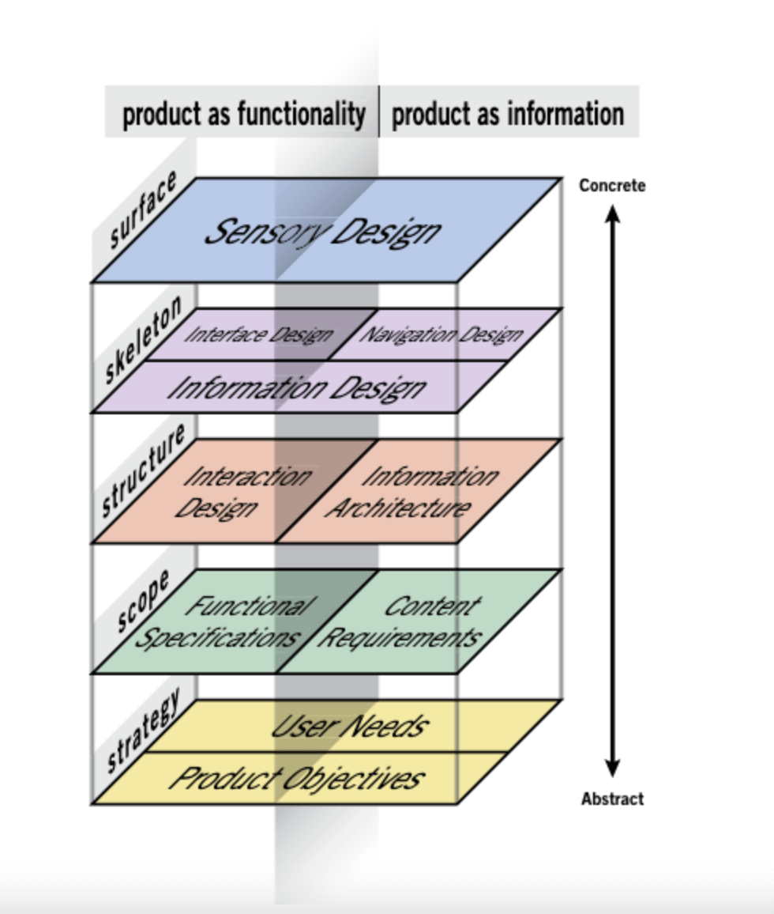
UX Planes

Slide 26
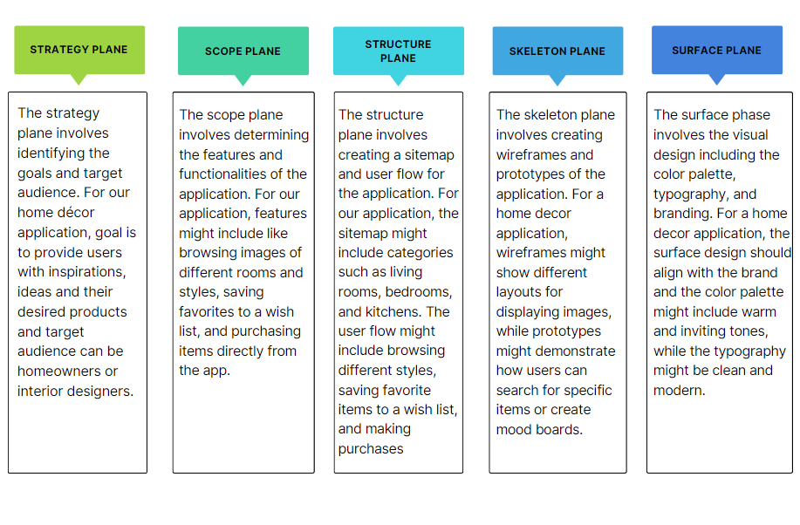

Slide 27
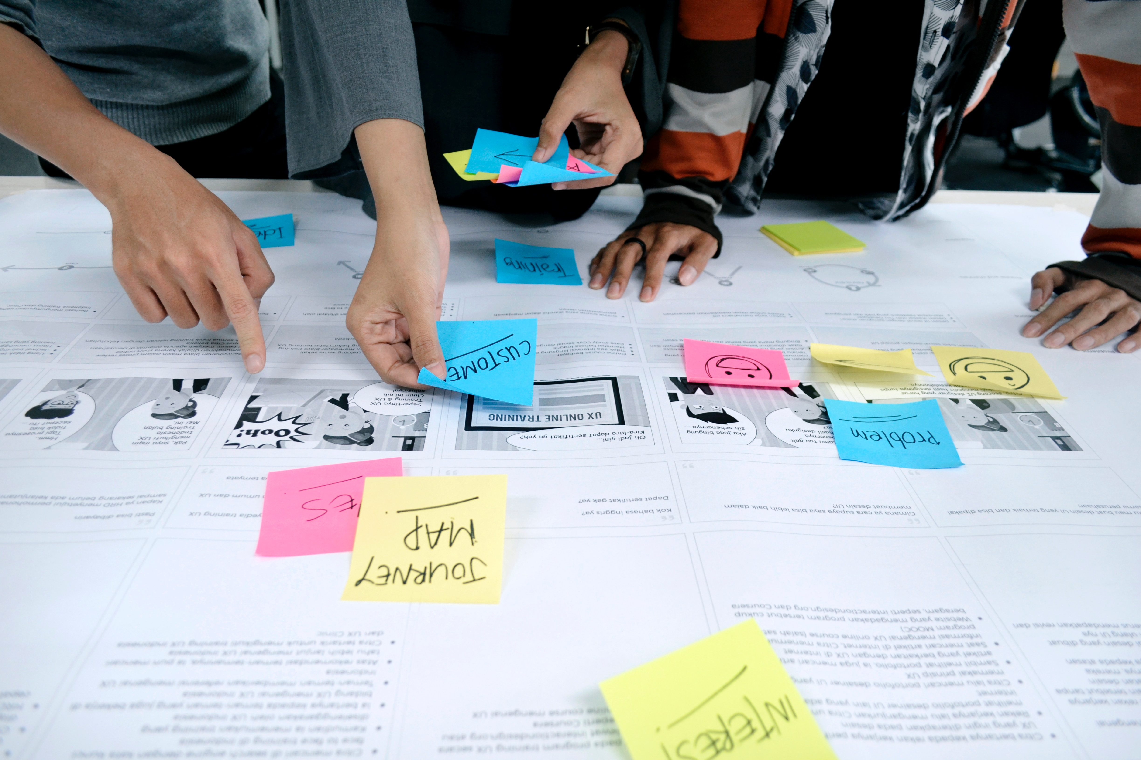
Research Methods

Slide 28
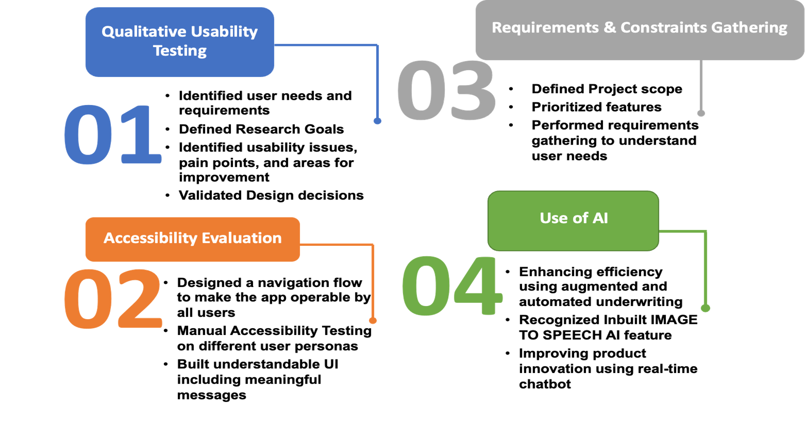
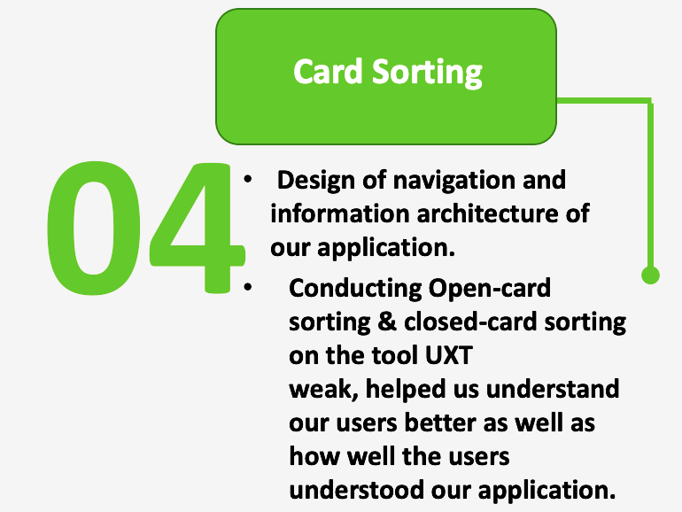

Slide 29

Usability Testing

Slide 30
How easy is it to find a specific type of product on the app? | What are your thoughts on the overall design of the app? | Can you describe the process of adding a product to your wish list or cart? | How easy is it to use the app on a mobile device? | Are there any features or functions that you wish were available in the app?
Very easy | The UI is designed with the user's needs and preferences kept in mind. | Searching the desired product in search bar or categories | Simple and intuitive interface | Customers expect personalization and customization in products and services.
Products are distributed into different categories and tags used are amazing. | The visual design is aesthetically pleasing and visually appealing to the user. | Viewing its product details and selecting the product | Clear and concise text | Able to customize their selection by choosing size, color, and style over a wide range of products.
Appropriate categorization. Loved browsing products for Room, Kitchen seperately. | It uses appropriate color schemes, typography, and other design elements that enhance the user's experience. | Selecting the quantity of that particular product to add in cart. | Appropriate Visual elements | Voice accesibilty
Offers and deals on the products are easier to find | Consistency in design is maintained. Attractive UI. Impressive logo. | Adding it to cart and checking out with doing payment process. | Proper demo instructions in onboarding screens | Ability to customize designs

Slide 31
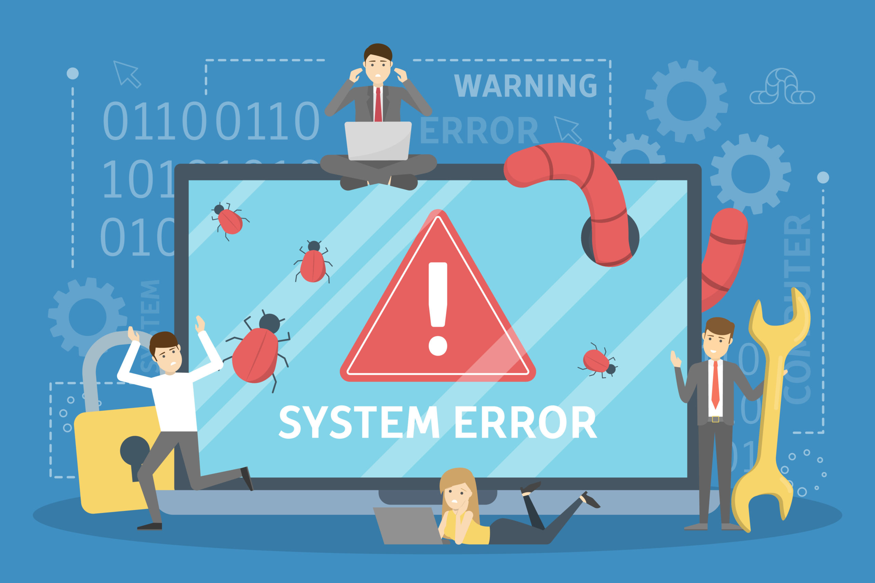
Error Handling

Slide 32
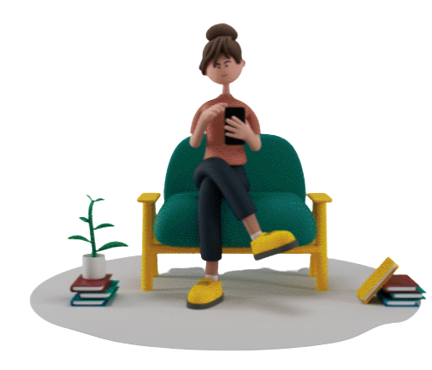
We included error handling to alleviate some of the pain points from error experiences.
We tried to make our messages descriptive like "Email should contain an @ and . Characters" or "Password should be at least 8 characters long".
The main objective of error handling is to maintain the normal flow of the application and ensure app stability.
In our project, we have added error handling in sign up and sign in pages. For example, users will be notified when they enter incorrect email and password. In addition, if there is a problem, an error message will be displayed to provide guidance on how to fix it.
Notes:
We included error handling to alleviate some of the pain points from error experiences. This is necessary as it helps remove frustration and informs users about the state of a field at the early stages, rather than user filling all the fields only to be redirected to an erroneous page.
We tried to make our messages descriptive like "Email should contain an @ and . Characters" or "Password should be at least 8 characters long". These descriptions helps user know what they are doing wrong and help correct their mistakes.
The main objective of error handling is to maintain the normal flow of the application and ensure app stability.
In our project, we have added error handling in sign up and sign in pages. For example, users will be notified when they enter incorrect email and password. In addition, if there is a problem, an error message will be displayed to provide guidance on how to fix it.

Slide 33
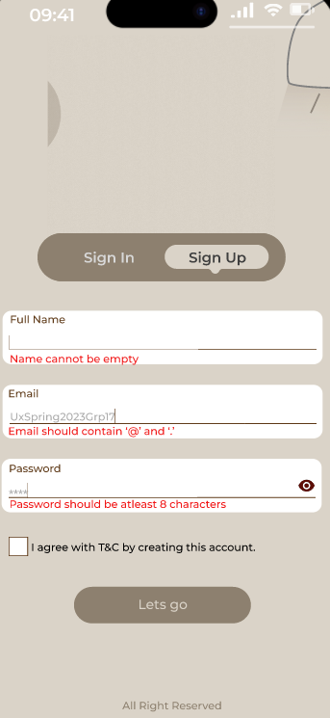
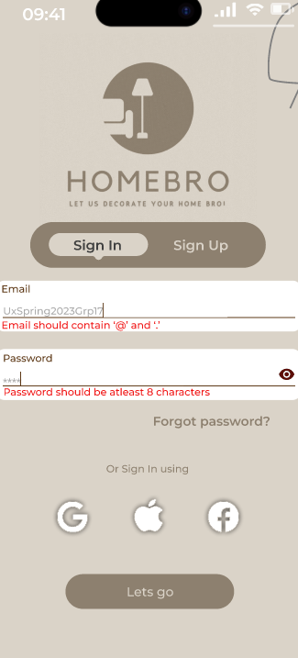

Slide 34
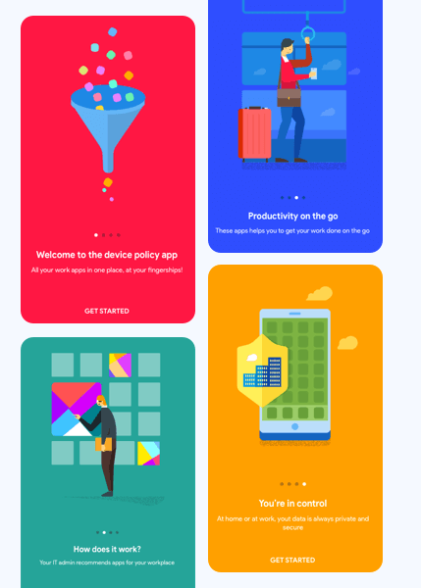
Onboarding

Slide 35
Before Sign Up: Minimal details (like name, email, password) would be gathered during Sign Up.
Interactive tour / Joyriding: We added step by step guiding on different parts, highlighting with short explanation to introduce users with various options and features within our app.
Demo Space: Users would be allowed to explore our app freely. Since our UI is very intuitive and provides a similar experience as other apps in the space, users should not have a hard time navigating through the app.
Continued Onboarding: For some of the newer features like the AR feature, users are provided with some contextual help features like an info icon which opens a modal to better explain the use of the AR feature.
Notes:
Step-by-Step guiding: We added step by step guiding on different parts, highlighting with short explanation to introduce users with various options and features within our app.
Minimal user details (like name, email, password) would be gathered. Users can head to the profile page to complete the rest of the details any time they want. If required, certain details will be gathered when necessary (like address and payment details in case of checkout).
Exploration: Users would be allowed to explore our app freely. Since our UI is very intuitive and provides a similar experience as other apps in the space, users should not have a hard time navigating through the app. This provides a clean onboarding experience where the user doesn’t feel they have a list of tasks to clear or are being handheld.
Additional details for new features: for some of the newer features like the AR feature, users are provided with some contextual help features like an info icon which opens a modal to better explain the use of the AR feature.

Slide 36
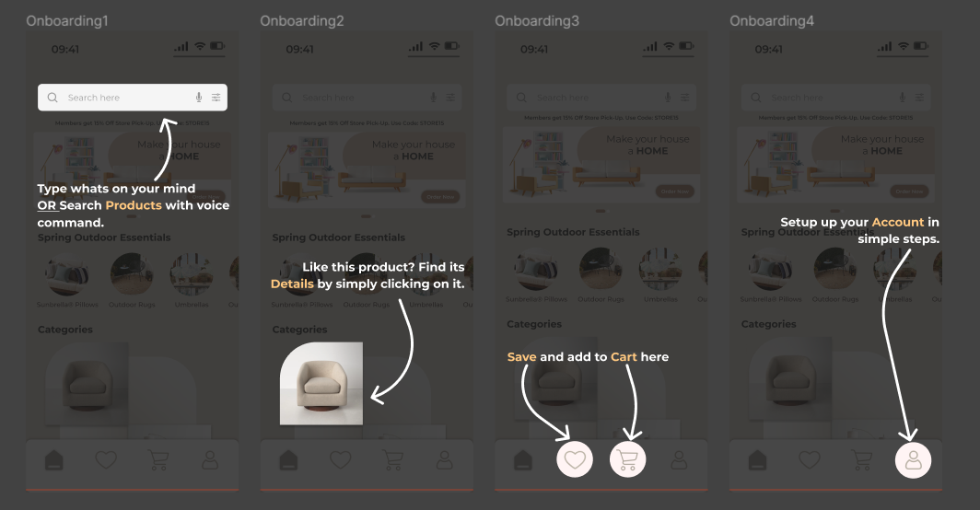

Slide 37

Thank You
Feedbacks are appreciated

